Slide 1
GNU Radio: gr-radar
Samson Aggelopoulos, Willy Chang, Brian Lu, and Matthew Sahara

Slide 2

Topics
Harmonic Radar
GNU Radio/gr-radar
GNU Radio Set-Up
Integration with CRB Harmonic Radar
CW Dual Radar
Transponder Overview
Power Amplifier Update

Slide 3
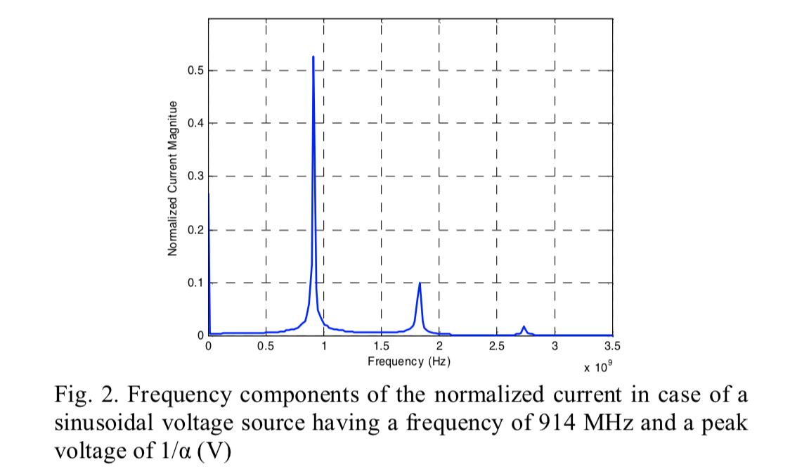
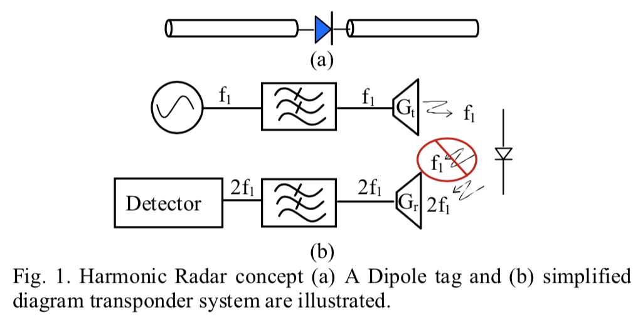
Harmonic Radar
Standard Harmonic Radar System Overview [1]
Notes:
Samson

Slide 4
GNU Radio
An open source, and free software radio toolkit
Capable of acting as a simulation environment or as a software defined radio with RF components
Software defined radio is a platform for signal processing using physical RF components
Best suited for us as we can reuse hardware for different applications
GNU Radio can also be described as a block programming interface
Signal processing and other elements are represented as blocks in the GUI, which you drag and connect to other blocks
GNU Radio is only a platform for software defined radios, which comes with limited functionality, but it is open source
Notes:
Brian

Slide 5
GR Radar
GR Radar is a third party contribution to GNU Radio with support for additional radar functionality including:
Templates for CW, FSK, and Dual CW
GR Radar utilizes a single or dual USRP from Ettus with their UHD
Notes:
Willy

Slide 6
Progress (Set Up)
Installed GNU Radio companion (3.8.2)
From the stable PPA release
Installed gr-radar
Cloned from primercuevero’s version
Supports GNU Radio 3.8.2
Installed missing dependencies (e.g. swig, uhd, etc.)
Library unable to locate modules
Identified that the toolbox isn’t installed in the ‘radar’ library
Look into source code to install modules
Notes:
Willy

Slide 7
Grand Plan
Fully Functional Harmonic Radar
Track CRB via harmonic radar
Detect obstacles using higher fundamental frequency
File transfer via mmWave
Notes:
Samson

Slide 8
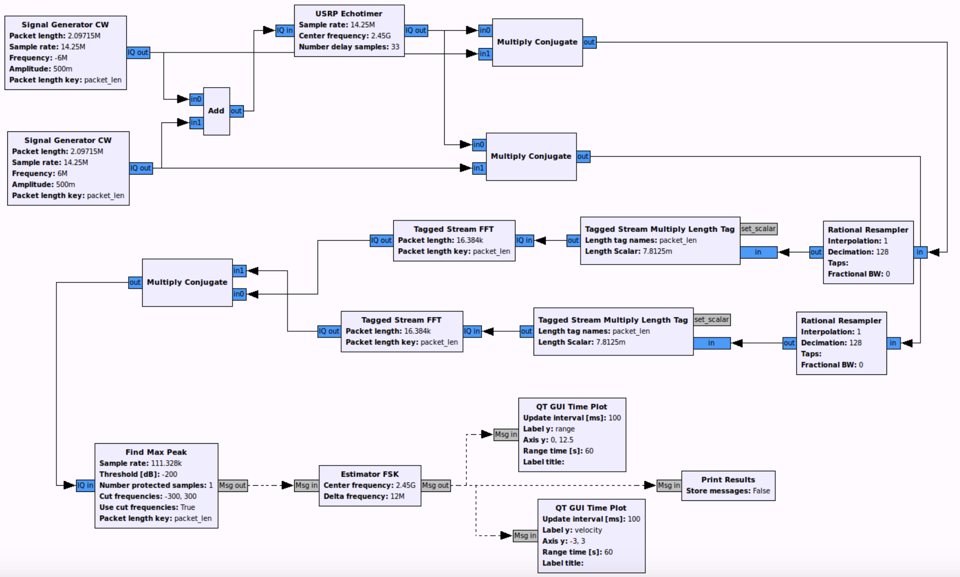
CW Dual Radar
Notes:
Samson/Willy

Slide 9
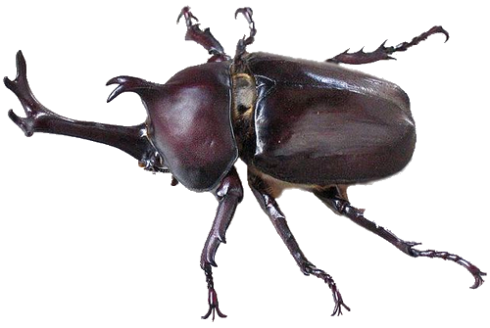
Transponder Overview
Uses harmonic characteristic of diode
2x frequency
Diode is slightly capacitive
Updates with Lavrenko (2020)
Tune antenna and account for diode with parallel inudctor
New potential antenna
Diode harmonics function below 10 GHz (good for SDR test)
𝑓_{o}
𝑓₁
rebloggy.com
Notes:
Matthew

Slide 10
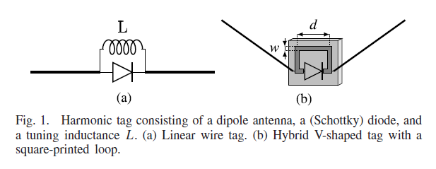
Transponder Updates
Dipole Transponder Design [2]
Diode is capacitive
Use a printed loop to serve as an inductor (printed loop)
Similar to RLC resonance?
rebloggy.com
Notes:
Matthew

Slide 11
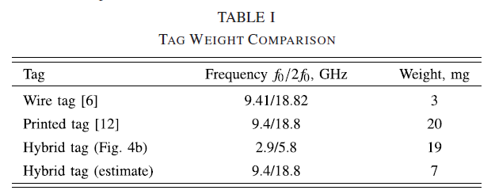
Transponder Updates
Tag Weight Minimization [2]
Diode is capacitive
Use a printed loop to serve as an inductor
Similar to RLC resonance?
rebloggy.com
Notes:
Matthew

Slide 12
Transponder Updates
Frequency | λ (wavelength) | λ/2 (dipole length)
4 GHz | 74.948 mm | 37.474 mm
18 GHz | 16.655 mm | 8.328 mm
rebloggy.com
Notes:
Matthew

Slide 13
Transponder Designs
J-Pole Maggiora 2019
Bowtie Kiriazi 2007
V-Dipole Lavrenko 2020
Notes:
Matthew

Slide 14
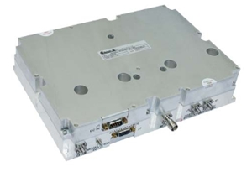
Power Amplifier Update
Amplifier Used in 2019 Paper “BPMC928109-1000”
GaN X Band Amplifier
Peak output of 1kW
60dB Gain
28Vdc
Notes:
Brian

Slide 15
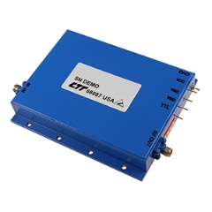
Power Amplifier Update Cont.
Prospective options “AGN/100-4855”
GaN Amplifier
Peak power of up to 1kW
CW output power of 63W
55dB Gain
30Vdc

Slide 16
Resources
[1] J. Kiriazi et al., “Low Profile Harmonic Radar Transponder for Tracking Small Endangered Species” in IEEE EMBS, August 2007. [Online]. Available: https://ieeexplore.ieee.org/document/4352795.
[2] A. Lavrenko et al., “Design and Evaluation of a Compact Harmonic Transponder for Insect Tracking” in IEEE Microwave and Wireless Components Letters, vol. 30, no. 4, April 2020. [Online]. Available: https://ieeexplore.ieee.org/document/9006943

